Slide 1
TensorFlow
Dr/Bahaa Helmy

Slide 2
Agenda
What is TensorFlow?
History of TensorFlow
How TensorFlow works
TensorFlow Architecture
Where can TensorFlow run?
Components of TensorFlow.
Why is TensorFlow popular?
List of Prominent Algorithms Supported by TensorFlow.
Simple TensorFlow Example

Slide 3
What is TensorFlow?
Open-source end-to-end platform for creating Machine Learning applications.
TensorFlow is a symbolic math library that uses dataflow and differentiable programming to perform various tasks focused on training and interface of deep neural networks.
It allow developers to create machine learning applications using various tools, libraries and community resources.
Google product uses machine learning in all of its products to improve the search engine, translation, image captioning or recommendations

Slide 4
History of TensorFlow
A couple of years ago,deep learning strted to outperform all other machine learning algorithms when giving massive amount of data.
Google saw it could use these deep neural networks to improve its services:
Gmail
Photo
Google search engine
They build a framework called TensorFlow to let researchers and developers work together on AI model.
Once develop and scaled, it allows lots of people to use it.

Slide 5
Cont..
It was first made public in late 2015, while the first stable version appeared in 2017. It is open source under Apache Open Source license.
You can use it, modify it and redistribute the modified version for a fee without paying anything to Google.

Slide 6
How TensorFlow Works
TensorFlow enables you to build dataflow graphs and structures to define how data moves through a graph by taking inputs as a multi-dimensional array called Tensor.
It allows you to construct a flowchart of operations that can be performed on these inputs, which goes at one end and comes at the other end as output.

Slide 7
TensorFlow Architecture
Tensorflow architecture works in three parts:
Preprocessing the data
Build the model
Train and estimate the model
It is called Tensorflow because it takes input as a multi-dimensional array, also known as tensors.
You can construct a sort of flowchart of operations (called a Graph) that you want to perform on that input. The input goes in at one end, and then it flows through this system of multiple operations and comes out the other end as output.

Slide 8
Where can Tensorflow run?
TensorFlow hardware, and Software requirements can be classified into
Development Phase: This is when you train the mode. Training is usually done on your Desktop or laptop.
Run Phase or Inference Phase: Once training is done Tensorflow can be run on many different platforms. You can run it on
Desktop running Windows, macOS or Linux
Cloud as a web service
Mobile devices like iOS and Android

Slide 9
Components of TensorFlow
Tensor
Tensorflow's name is directly derived from its core framework: Tensor. In Tensorflow, all the computations involve tensors. A tensor is a vector or matrix of n-dimensions that represents all types of data. All values in a tensor hold identical data type with a known (or partially known) shape. The shape of the data is the dimensionality of the matrix or array.
A tensor can be originated from the input data or the result of a computation. In TensorFlow, all the operations are conducted inside a graph. The graph is a set of computation that takes place successively. Each operation is called an op node and are connected to each other.
The graph outlines the ops and connections between the nodes. However, it does not display the values. The edge of the nodes is the tensor, i.e., a way to populate the operation with data.

Slide 10
Cont..
Graphs
TensorFlow makes use of a graph framework. The graph gathers and describes all the series computations done during the training. The graph has lots of advantages:
It was done to run on multiple CPUs or GPUs and even mobile operating system
The portability of the graph allows to preserve the computations for immediate or later use. The graph can be saved to be executed in the future.
All the computations in the graph are done by connecting tensors together
A tensor has a node and an edge. The node carries the mathematical operation and produces an endpoints outputs. The edges the edges explain the input/output relationships between nodes.

Slide 11
Why is TensorFlow popular?
TensorFlow is the best library of all because it is built to be accessible for everyone.
Tensorflow library incorporates different API to built at scale deep learning architecture like CNN or RNN.
TensorFlow is based on graph computation; it allows the developer to visualize the construction of the neural network with Tensorboard.
This tool is helpful to debug the program. Finally, Tensorflow is built to be deployed at scale. It runs on CPU and GPU.
Tensorflow attracts the largest popularity on GitHub compare to the other deep learning framework.

Slide 12
List of Prominent Algorithms supported by TensorFlow
Below are the supported TensorFlow algorithms list:
Currently, TensorFlow 1.10 has a built-in API for:
Linear regression: tf.estimator.LinearRegressor
Classification:tf.estimator.LinearClassifier
Deep learning classification: tf.estimator.DNNClassifier
Deep learning wipe and deep: tf.estimator.DNNLinearCombinedClassifier
Booster tree regression: tf.estimator.BoostedTreesRegressor
Boosted tree classification: tf.estimator.BoostedTreesClassifier

Slide 13
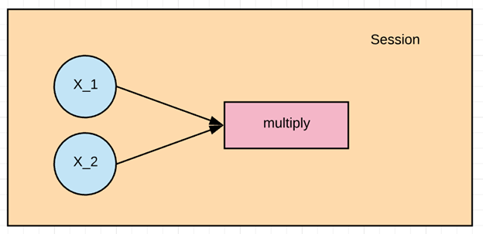
Simple TensorFlow Example
Let 's practice the elementary workflow of Tensorflow with simple TensorFlow examples. Let's create a computational graph that multiplies two numbers together.
During the example, we will multiply X_1 and X_2 together. Tensorflow will create a node to connect the operation. In our example, it is called multiply. When the graph is determined, Tensorflow computational engines will multiply together X_1 and X_2.

Slide 14

Cont..
Step 1: two line of code, we have imported tensorflow as tf.

Slide 15

Cont..
Step 2: Define the variable
When we create a placeholder node, we have to pass in the data type will be adding numbers here so we can use a floating-point data type, let's use tf.float32. We also need to give this node a name. This name will show up when we look at the graphical visualizations of our model. Let's name this node X_1 by passing in a parameter called name with a value of X_1 and now let's define X_2 the same way. X_2.

Slide 16

Cont..
Step 3: Define the computation
Now we can define the node that does the multiplication operation. In Tensorflow we can do that by creating a tf.multiply node.
We will pass in the X_1 and X_2 nodes to the multiplication node. It tells tensorflow to link those nodes in the computational graph, so we are asking it to pull the values from x and y and multiply the result. Let's also give the multiplication node the name multiply. It is the entire definition for our simple computational graph.

Slide 17
Step 4: Execute the operation
To execute operations in the graph, we have to create a session. In Tensorflow, it is done by tf.Session(). Now that we have a session we can ask the session to run operations on our computational graph by calling session. To run the computation, we need to use run.
When the addition operation runs, it is going to see that it needs to grab the values of the X_1 and X_2 nodes, so we also need to feed in values for X_1 and X_2. We can do that by supplying a parameter called feed_dict. We pass the value 1,2,3 for X_1 and 4,5,6 for X_2.
We print the results with print(result). We should see 4, 10 and 18 for 1x4, 2x5 and 3x6

Slide 18
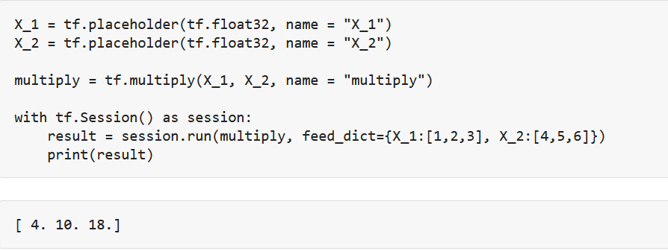
Cont..

Slide 19
References
https://github.com/aymericdamien/TensorFlow-Examples
https://github.com/easy-tensorflow/easy-tensorflow
https://www.tensorflow.org/tutorials/quickstart/beginner

